Slide 1
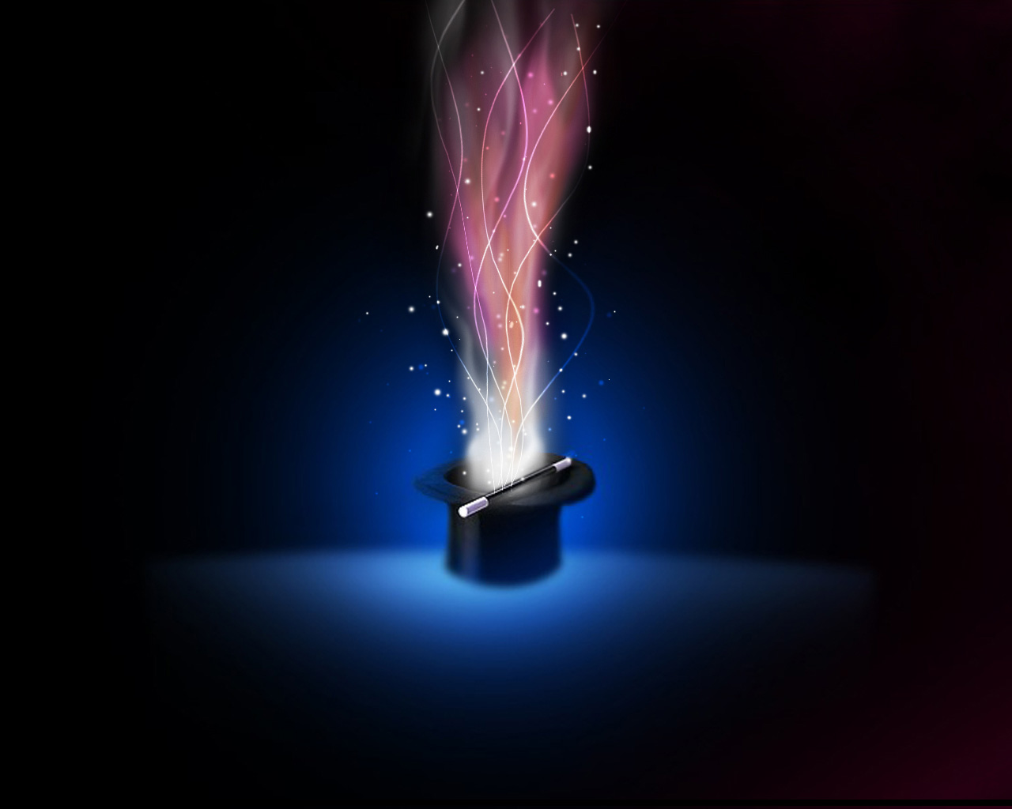

MAGIC OF THE AI BUILDER
Vivek Bavishi
AKA That API Guy

Slide 2





Thanks to our Sponsors!
Silver
Platinum
Gold

Slide 3

More Fun Stuff
Raffle: Please join us in the MPR at 4:45 PM for the raffle. We are raffling some exciting prizes (must be present to win)!!!
SharePint will be held from 5:15-?? at Sharp Edge Bistro (922 Penn Ave… a 4-minute walk). We have the lounge area at the front of the bar reserved. See Sandy for a beer ticket when you arrive!

Slide 4
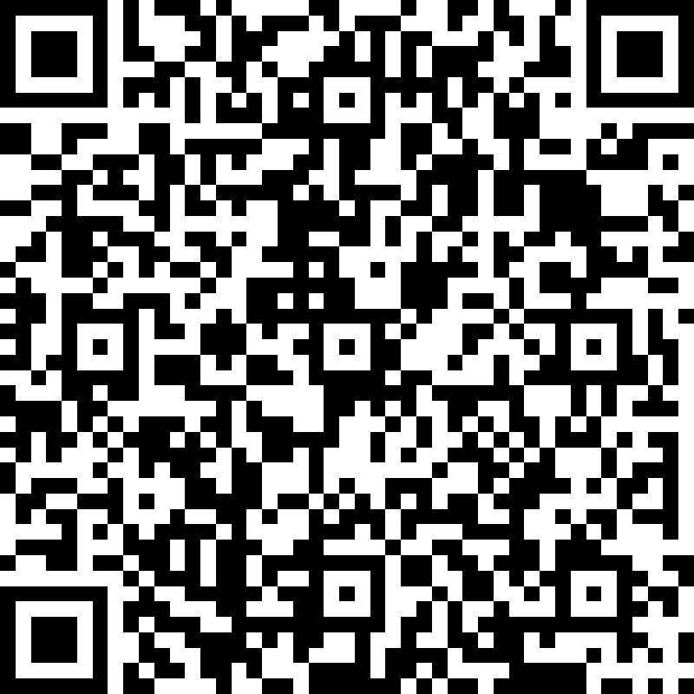
We do Request that…
You fill out the Session & Event evaluation form. Access the form after each session at bit.ly/SPSBurghEval OR scan this QR code (it’s also on the event schedule). Your EVENT eval enters you in the raffle; each SESSION eval gives you another entry!
You visit the sponsors. The event is possible due to their generous support and we request that you visit them and inquire about their products & services.
Cell phones be kept on silent as a courtesy to other attendees and speakers

Slide 5

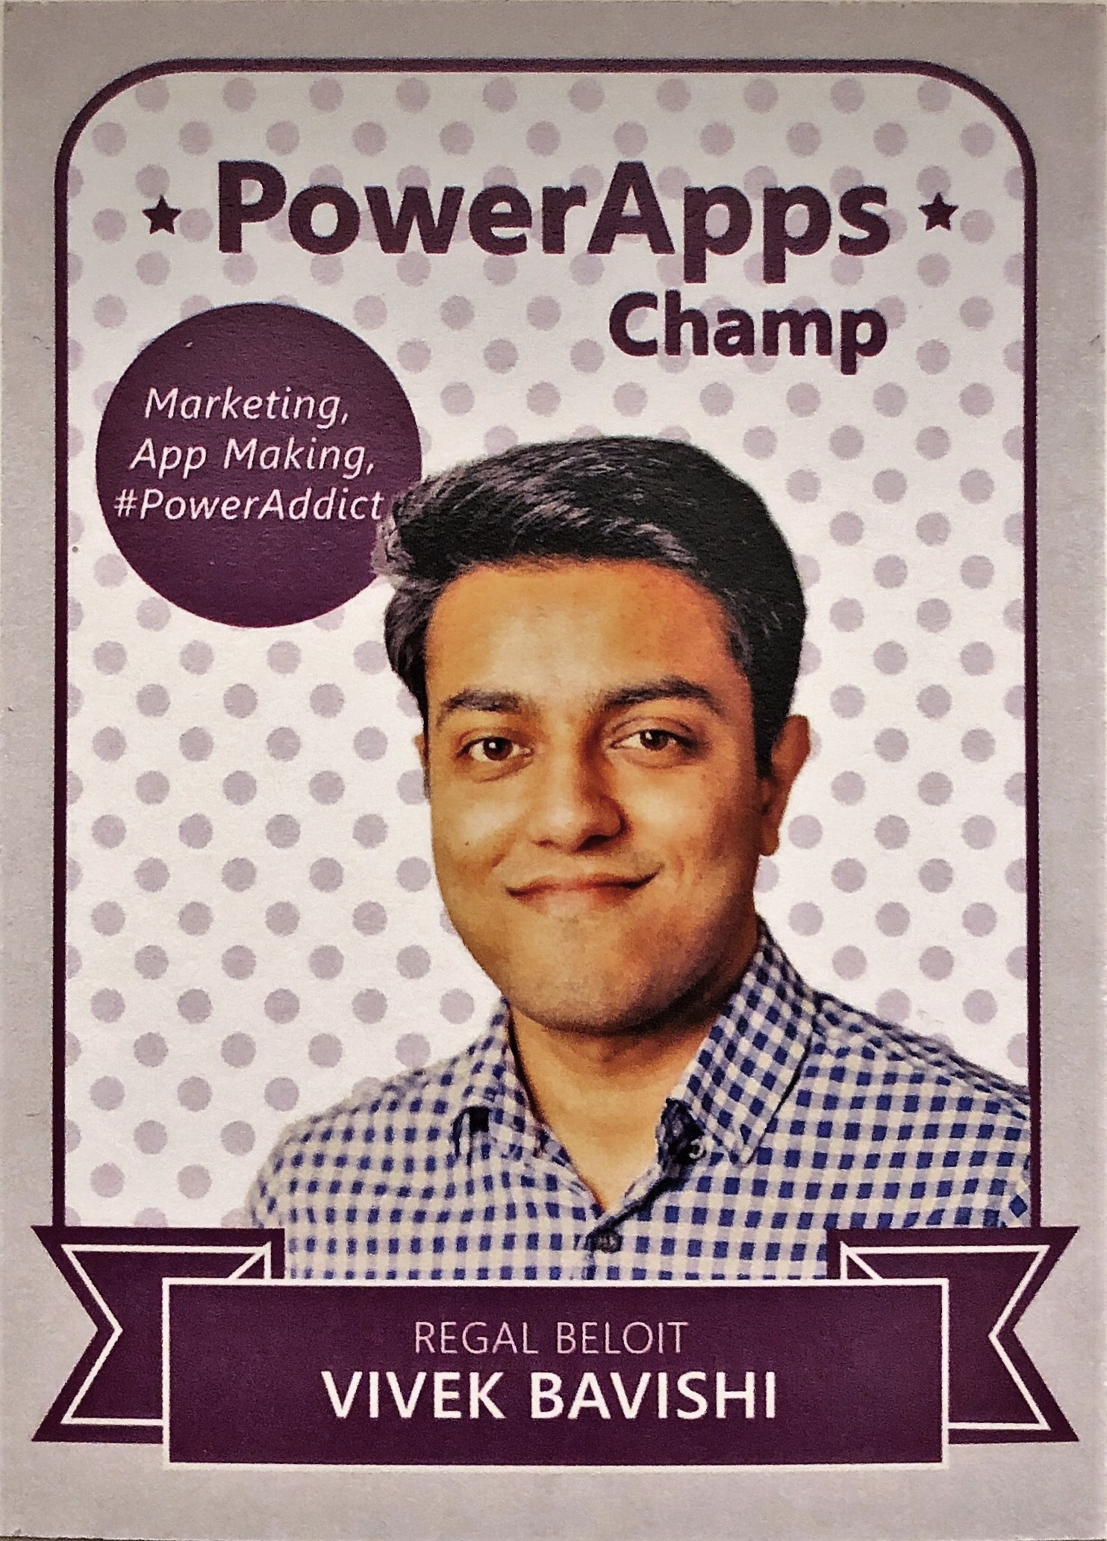



About me
Digital Customer Experience Manager
Cincinnati PowerApps & Flow User Group Leader
Addicted to PowerApps and Flow for 3 years.
#PowerAddict
@that_API_guy
That API Guy
thatapiguy.tech

Slide 6
Before we Start
Have you used PowerApps before?
Have you used Flow before?
Have you used Azure Cognitive Services?
Have you used the new AI Builder in PowerApps / Flow?

Slide 7
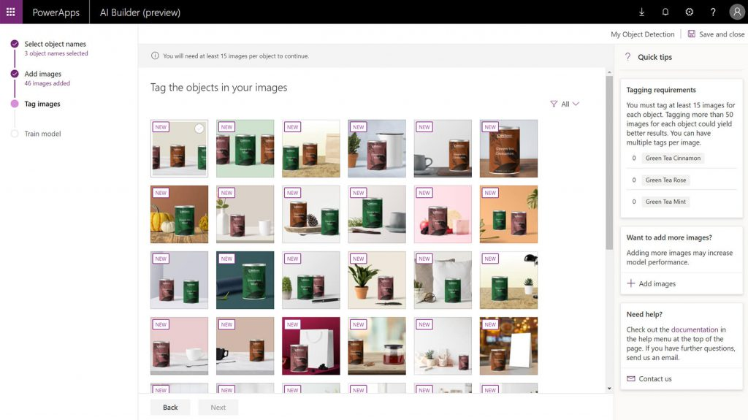
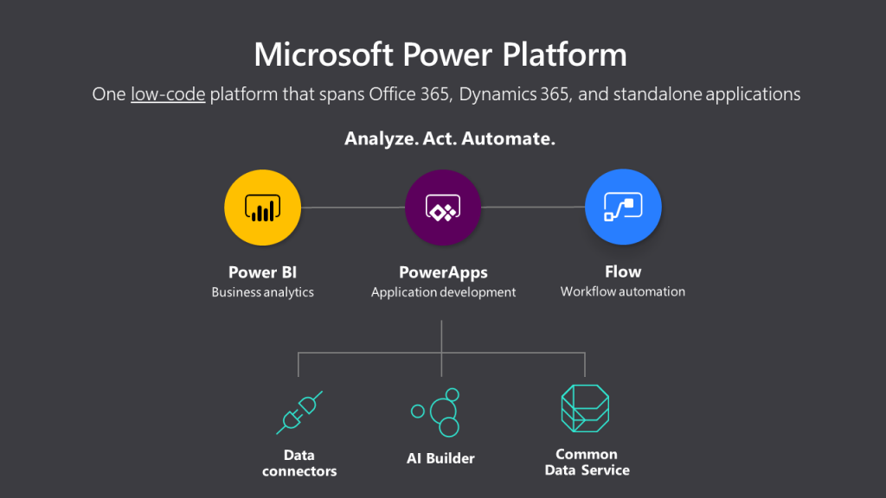
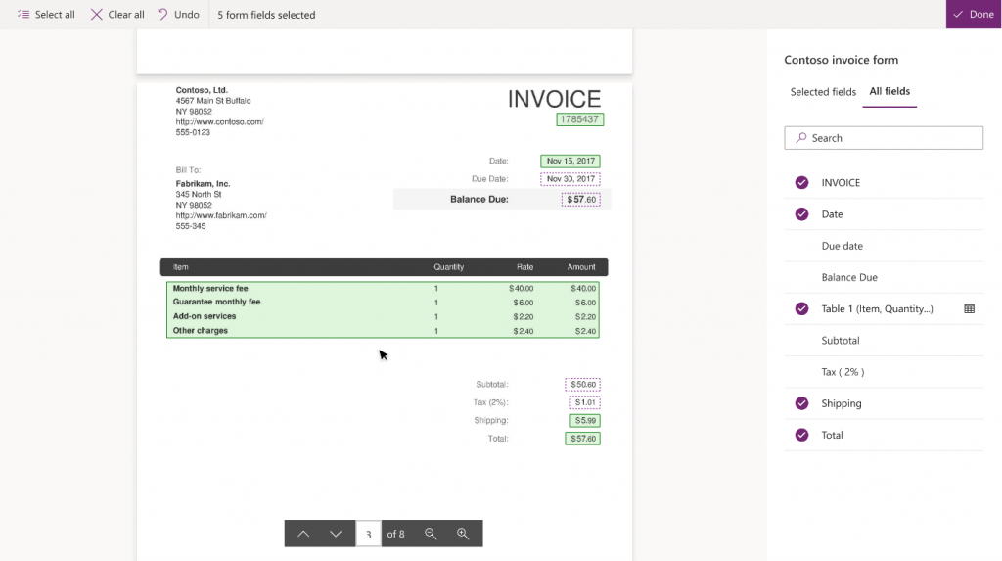
AI BUILDER
Launched at Microsoft Business Applications Summit
Key Capabilities
Object Detection
Form Processor
Business Card Scanner
Binary Classification
Text Classification
Docs - https://docs.microsoft.com/en-us/ai-builder/

Slide 8
What will we build today?
Scan business card and save it to Outlook contacts.
1
Identify a beer and send a quote to customer.
2
Analyze Purchase Order from customer and add details to SharePoint list.
3

Slide 9
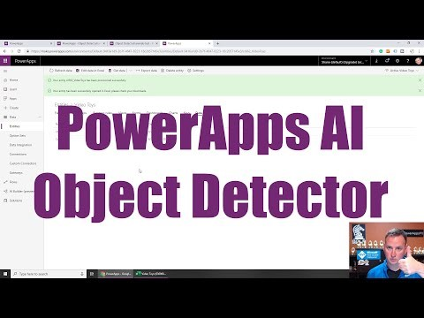
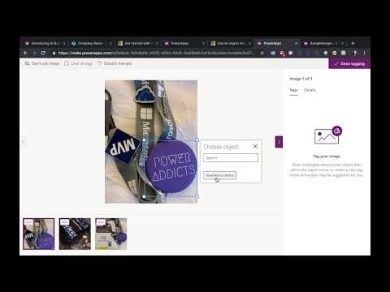
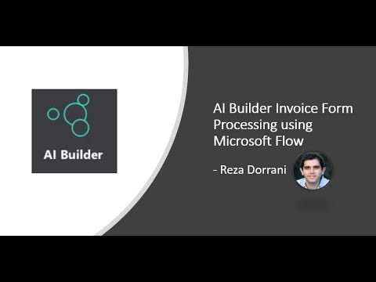
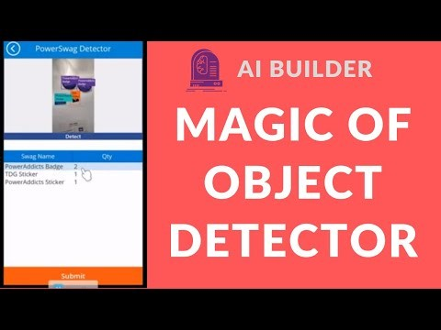
Other AI Builder Videos
Shane Young
April Dunnam
Reza Dorrani

Slide 10

Questions
@that_API_guy
That API Guy
thatapiguy.tech

Slide 11
We do Request that…
You fill out the Session & Event evaluation form. Access the form after each session at bit.ly/SPSBurghEval OR scan this QR code (it’s also on the event schedule). Your EVENT eval enters you in the raffle; each SESSION eval gives you another entry!
You visit the sponsors. The event is possible due to their generous support and we request that you visit them and inquire about their products & services.
Cell phones be kept on silent as a courtesy to other attendees and speakers

